Slide 1
Mechatronics
MTRN3026: Mechatronic Systems
MTRN3026 Mechatronic Systems

Slide 2
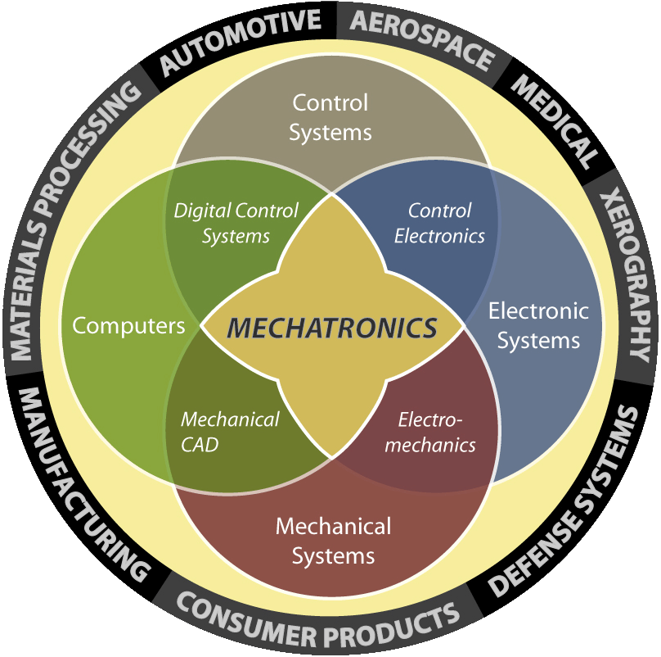
Mechatronics
Mechatronics is a multidisciplinary field of engineering that includes a combination of systems engineering, mechanical engineering, electrical engineering, Electronics and telecommunications engineering, control engineering and computer engineering.
The synergistic combination of mechanical, electrical, and computer engineering
  Emphasis on integrated design for products
  Optimal combination of appropriate technologies
MTRN3026 Mechatronic Systems

Slide 3
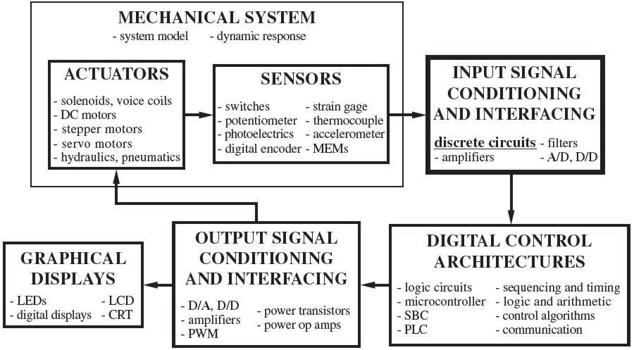
Components of Mechatronic Systems
MTRN3026 Mechatronic Systems

Slide 4
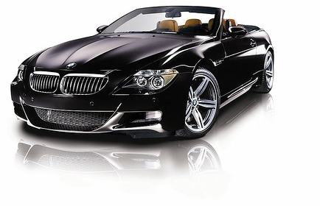

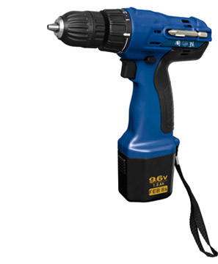
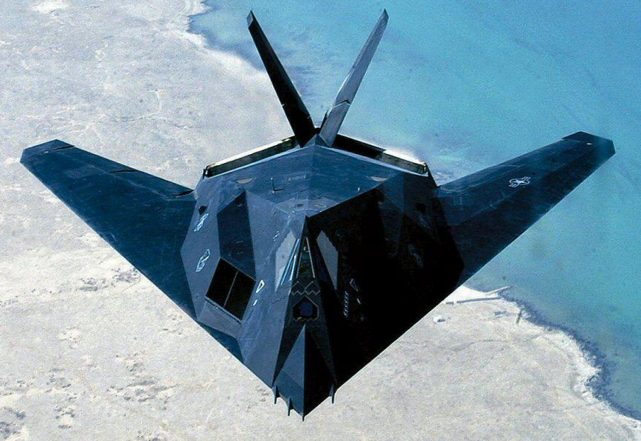
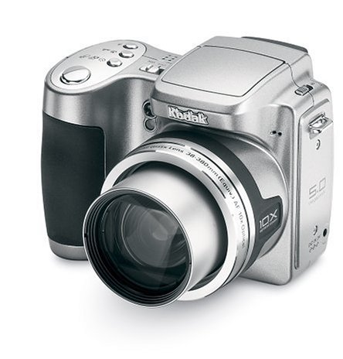
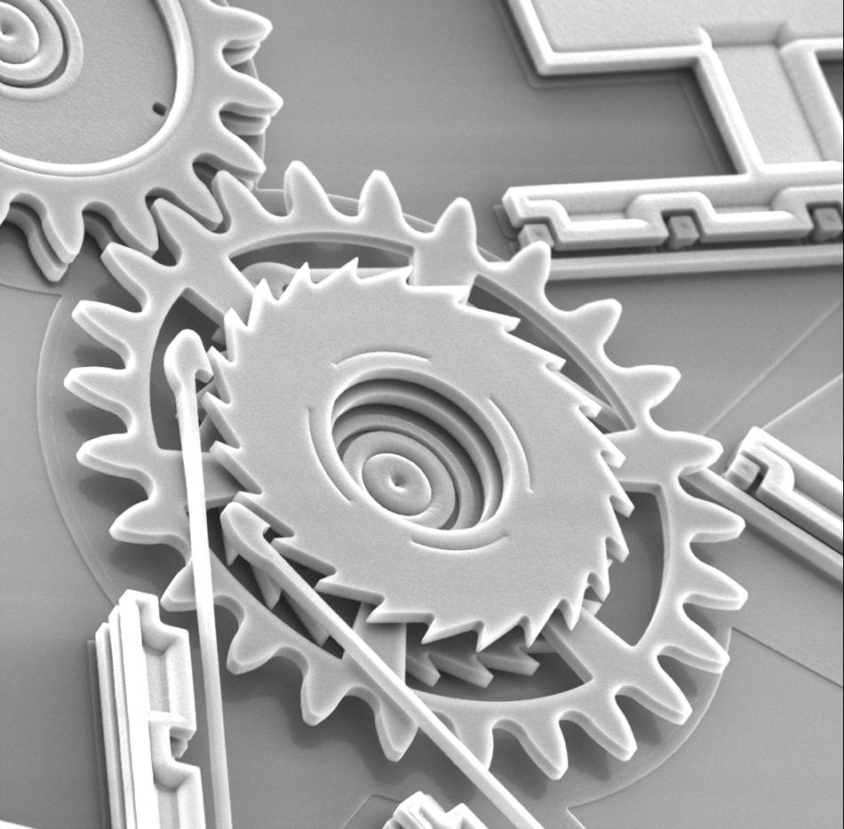
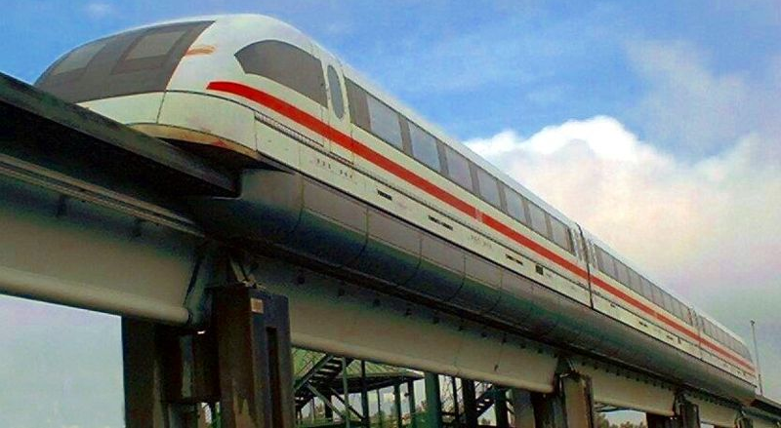
Examples of Mechatronics Systems
Computers
Cars
Tools
Stealth Bomber
Consumer Electronics
High Speed Trains
MEMS
Micro to Macro
Applications
MTRN3026 Mechatronic Systems

Slide 5
Summary of Mechatronics
The combination of mechanics, electronics, computer hardware and software, and control systems will revolutionize technology in the coming decades
This revolution will create exciting career opportunities in:
Automotive and Aerospace Industries
Medicine and Biomedical Industries
Robotics and Automated Manufacturing
Computer Hardware and Software Industries
Telecommunication Industries
Gaming and entertainment industries
We need broadly educated engineers trained in multi-disciplinary systems engineering to take advantage of the exciting career opportunities.
MTRN3026 Mechatronic Systems

Slide 6
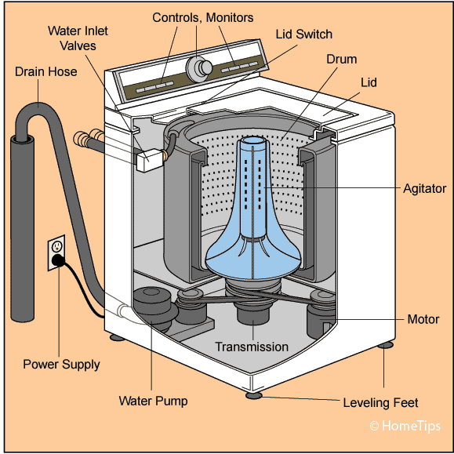
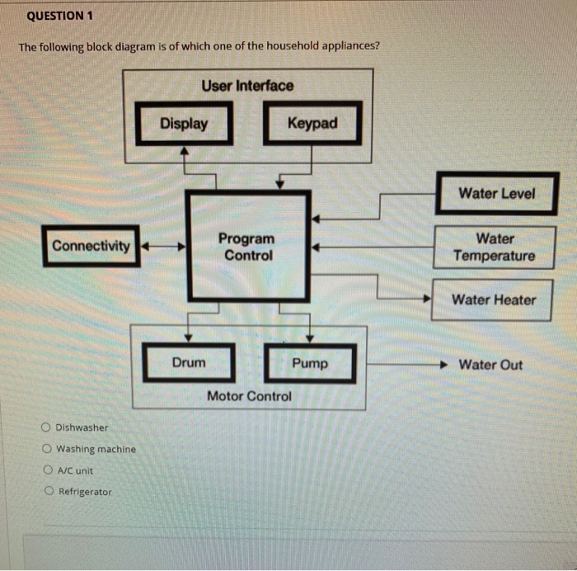
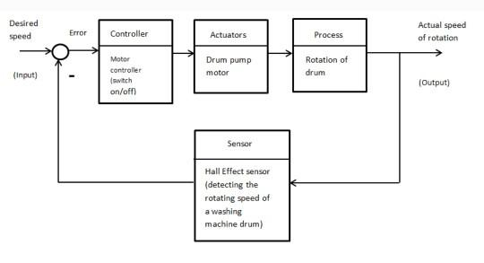
Functional block Diagram
MTRN3026 Mechatronic Systems

Slide 7
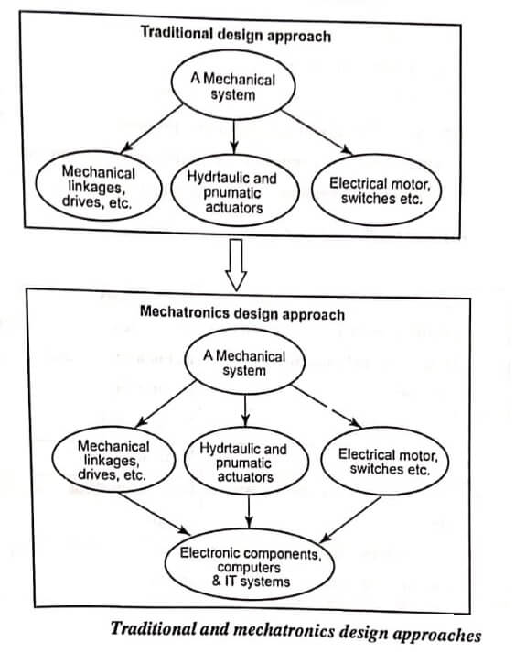
System Design Consideration
MTRN3026 Mechatronic Systems

Slide 8
Magnetic Circuit Analysis
MTRN3026 Mechatronic Systems

Slide 9
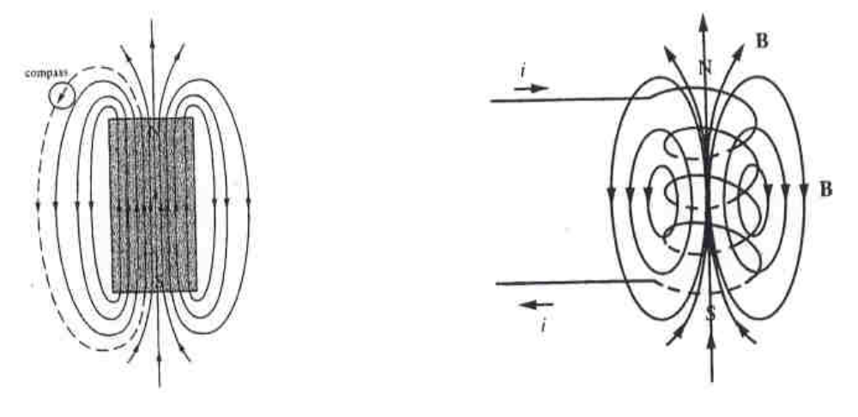
Generation of Magnetic Field
Permanent magnet materials
1. Neodymium Iron Boron (NdFeB)
2. Samarium Cobalt (SmCo)
3. Ceramic
4. Alnico
MTRN3026 Mechatronic Systems

Slide 10
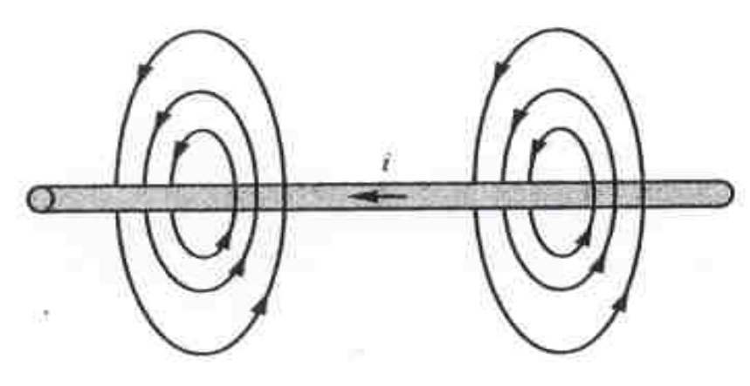
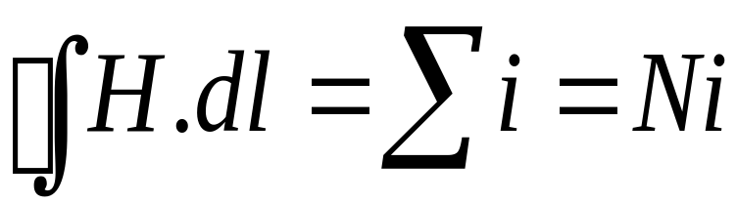
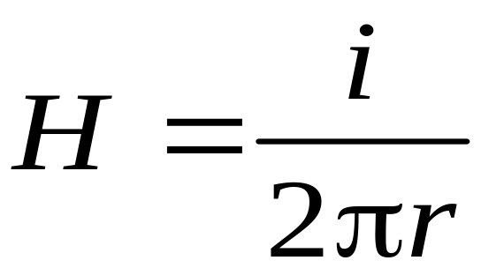
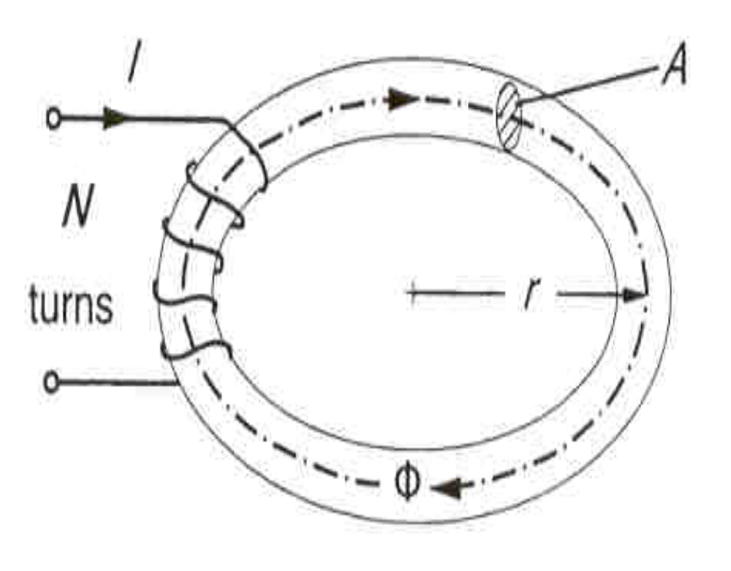
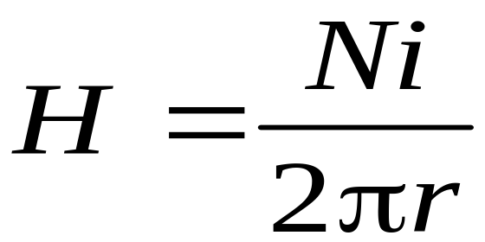
Magnitude and Direction of Magnetic field
Ampere’s circuital law
r is the distance of the point from the conductor
r is the mean radius of the core
MTRN3026 Mechatronic Systems

Slide 11
Magnetomotive Force
I
I
L
emf
R
H
N
electric circuit
magnetic circuit
In magnetic circuit we are generally concerned with the determination of the magnetic fluxes, magnetic field intensities in various parts of a circuit.
MTRN3026 Mechatronic Systems

Slide 12
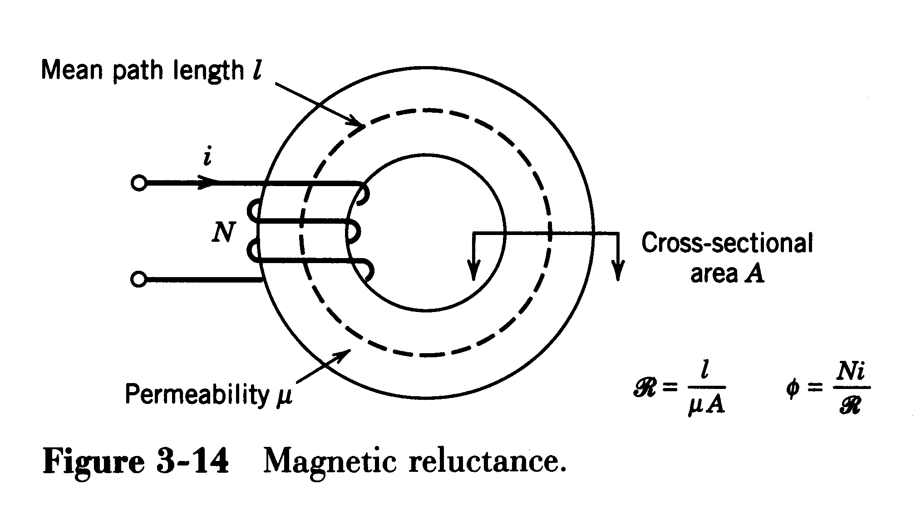
Concept of Magnetic Reluctance
Flux is related to ampere-turns by reluctance
MTRN3026 Mechatronic Systems

Slide 13
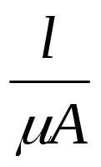
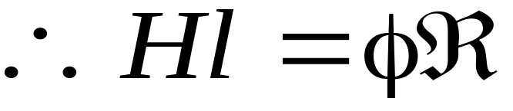

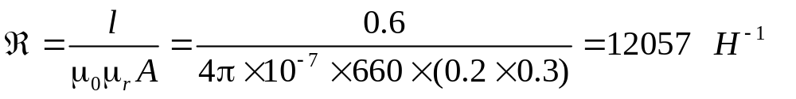
R =
- Reluctance of the magnetic circuit element – it is a measure of how difficult it is to establish magnetic flux in the element.
Example
φ
20cm
Find R, if μ_{r}=660
60cm
30cm
MTRN3026 Mechatronic Systems

Slide 14
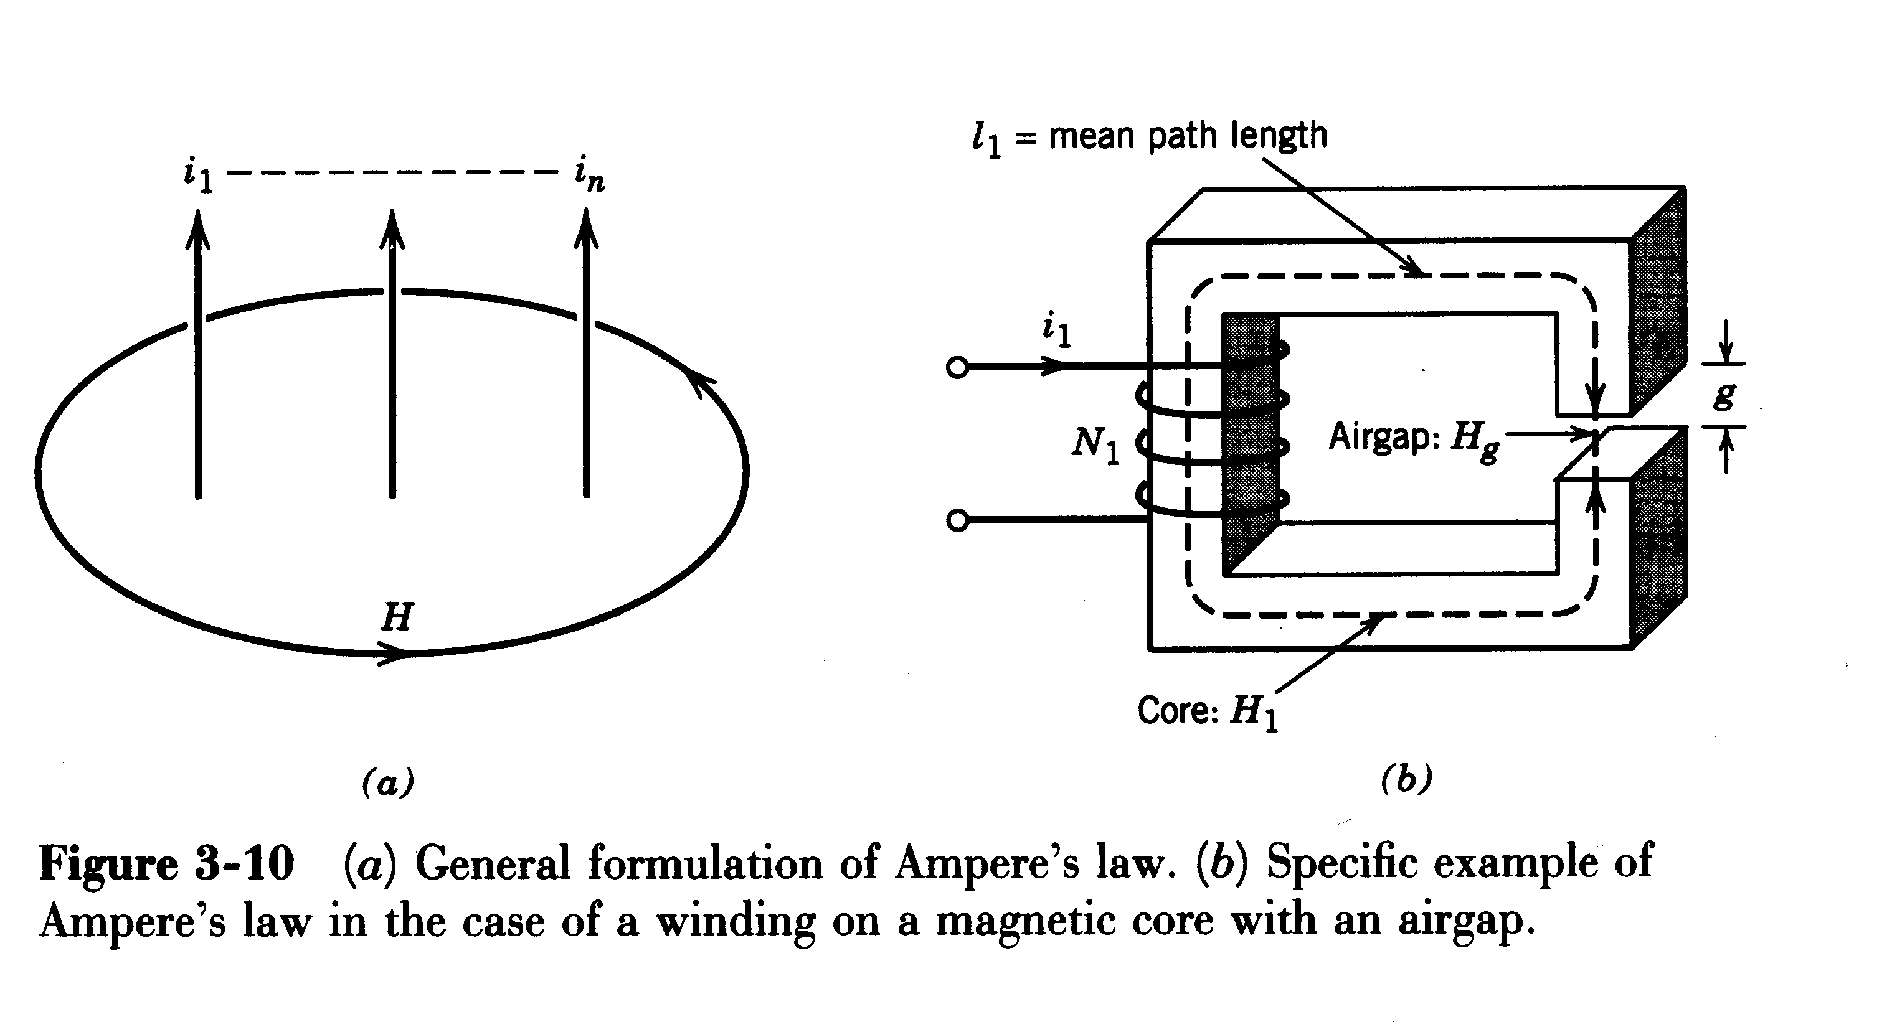
Ampere’s Law
Direction of magnetic field due to currents
Ampere’s Law: Magnetic field along a path
MTRN3026 Mechatronic Systems

Slide 15
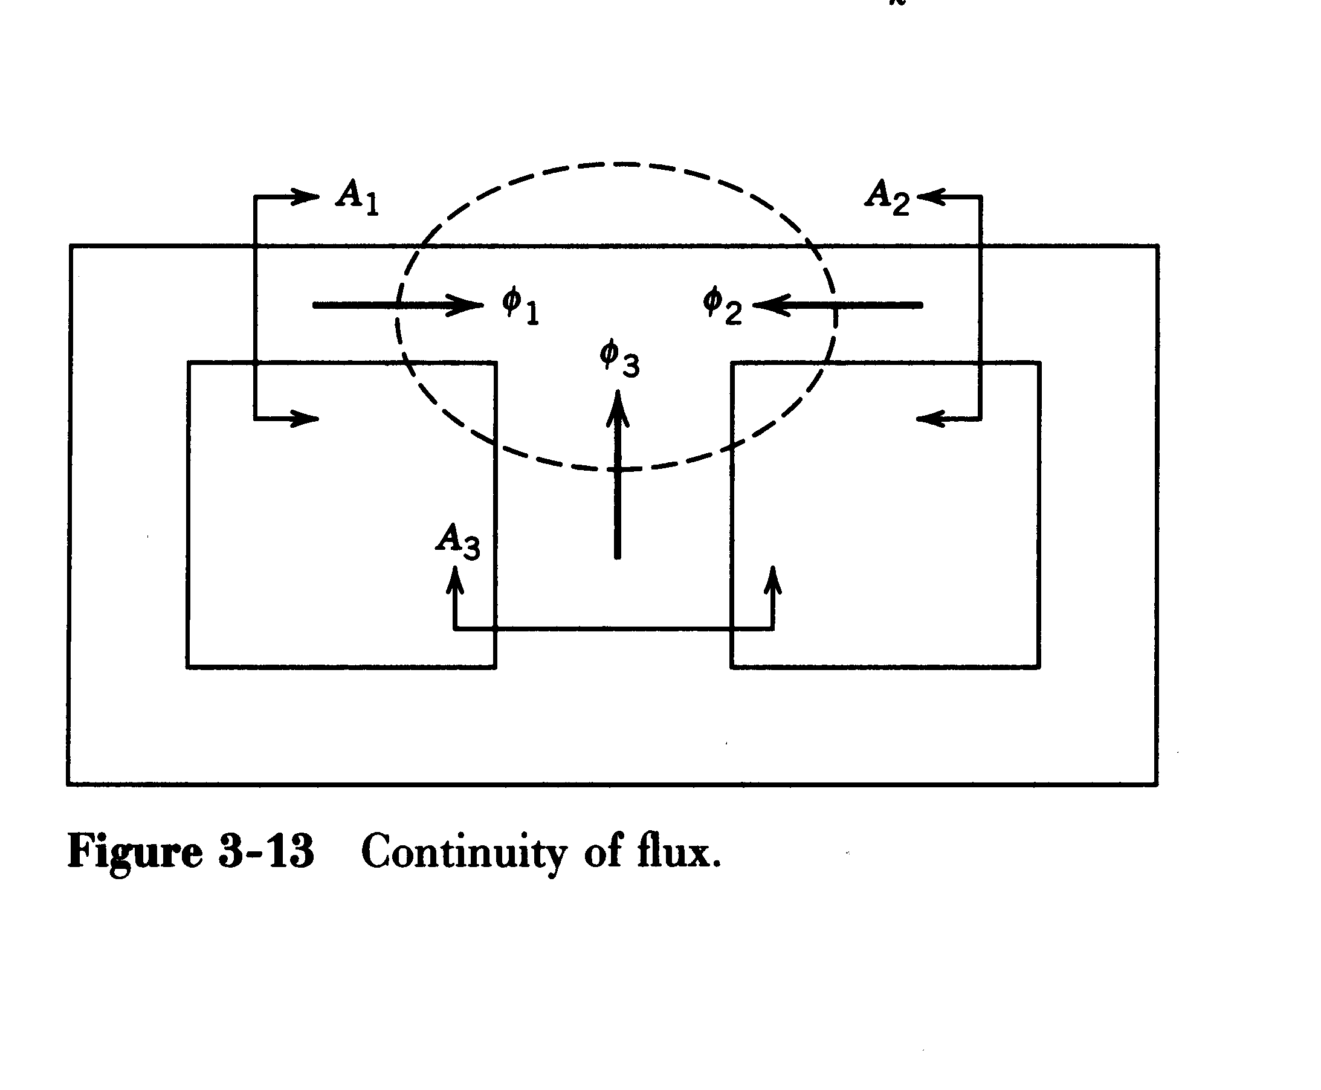
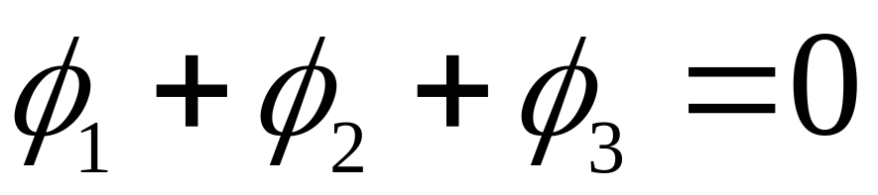
Continuity of Flux Lines
MTRN3026 Mechatronic Systems

Slide 16
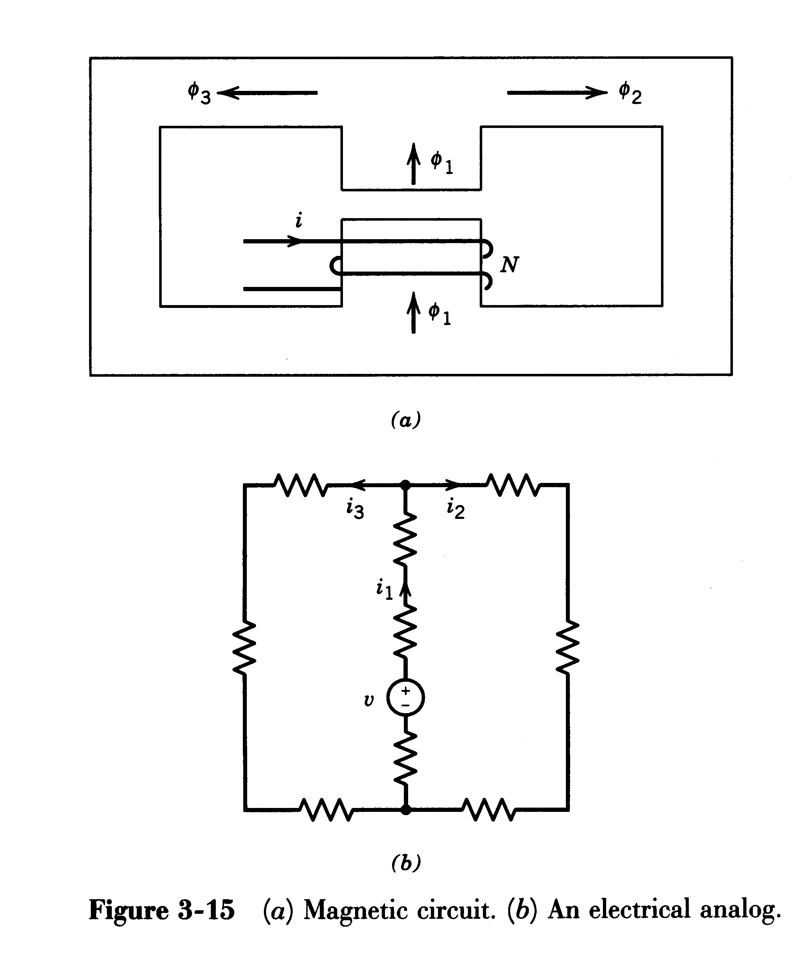
Magnetic Circuit and its Electrical Analog
MTRN3026 Mechatronic Systems

Slide 17

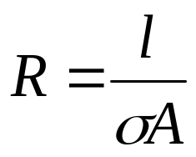
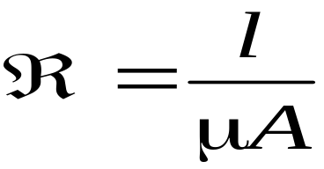
Analogy between Equations in Electrical and Magnetic Circuits
Electric Circuit
Magnetic Circuit
emf E
mmf F
Current I
Flux φ
Resistance R
Reluctance R
Conductivity σ
Permeability μ
F = φ R
MTRN3026 Mechatronic Systems

Slide 18
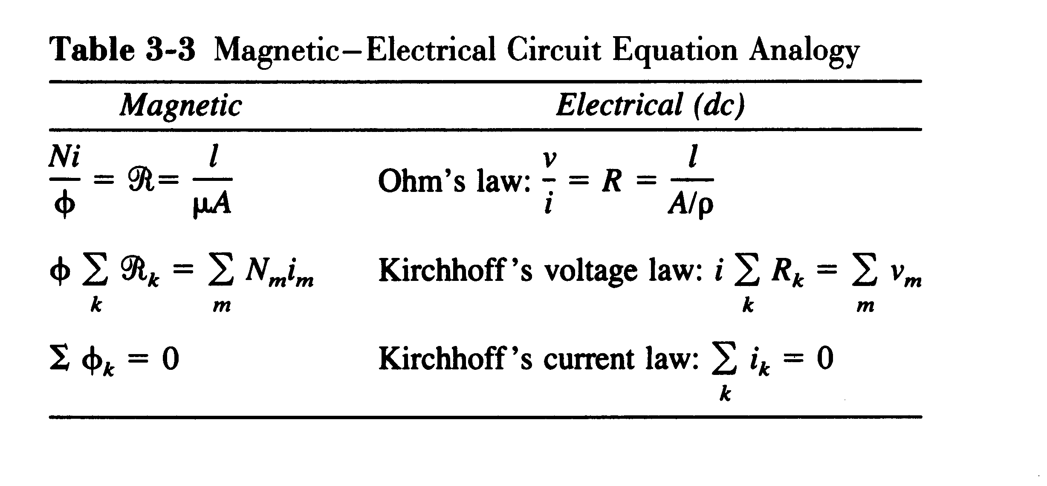
Analogy between Equations in Electrical and Magnetic Circuits
MTRN3026 Mechatronic Systems

Slide 19
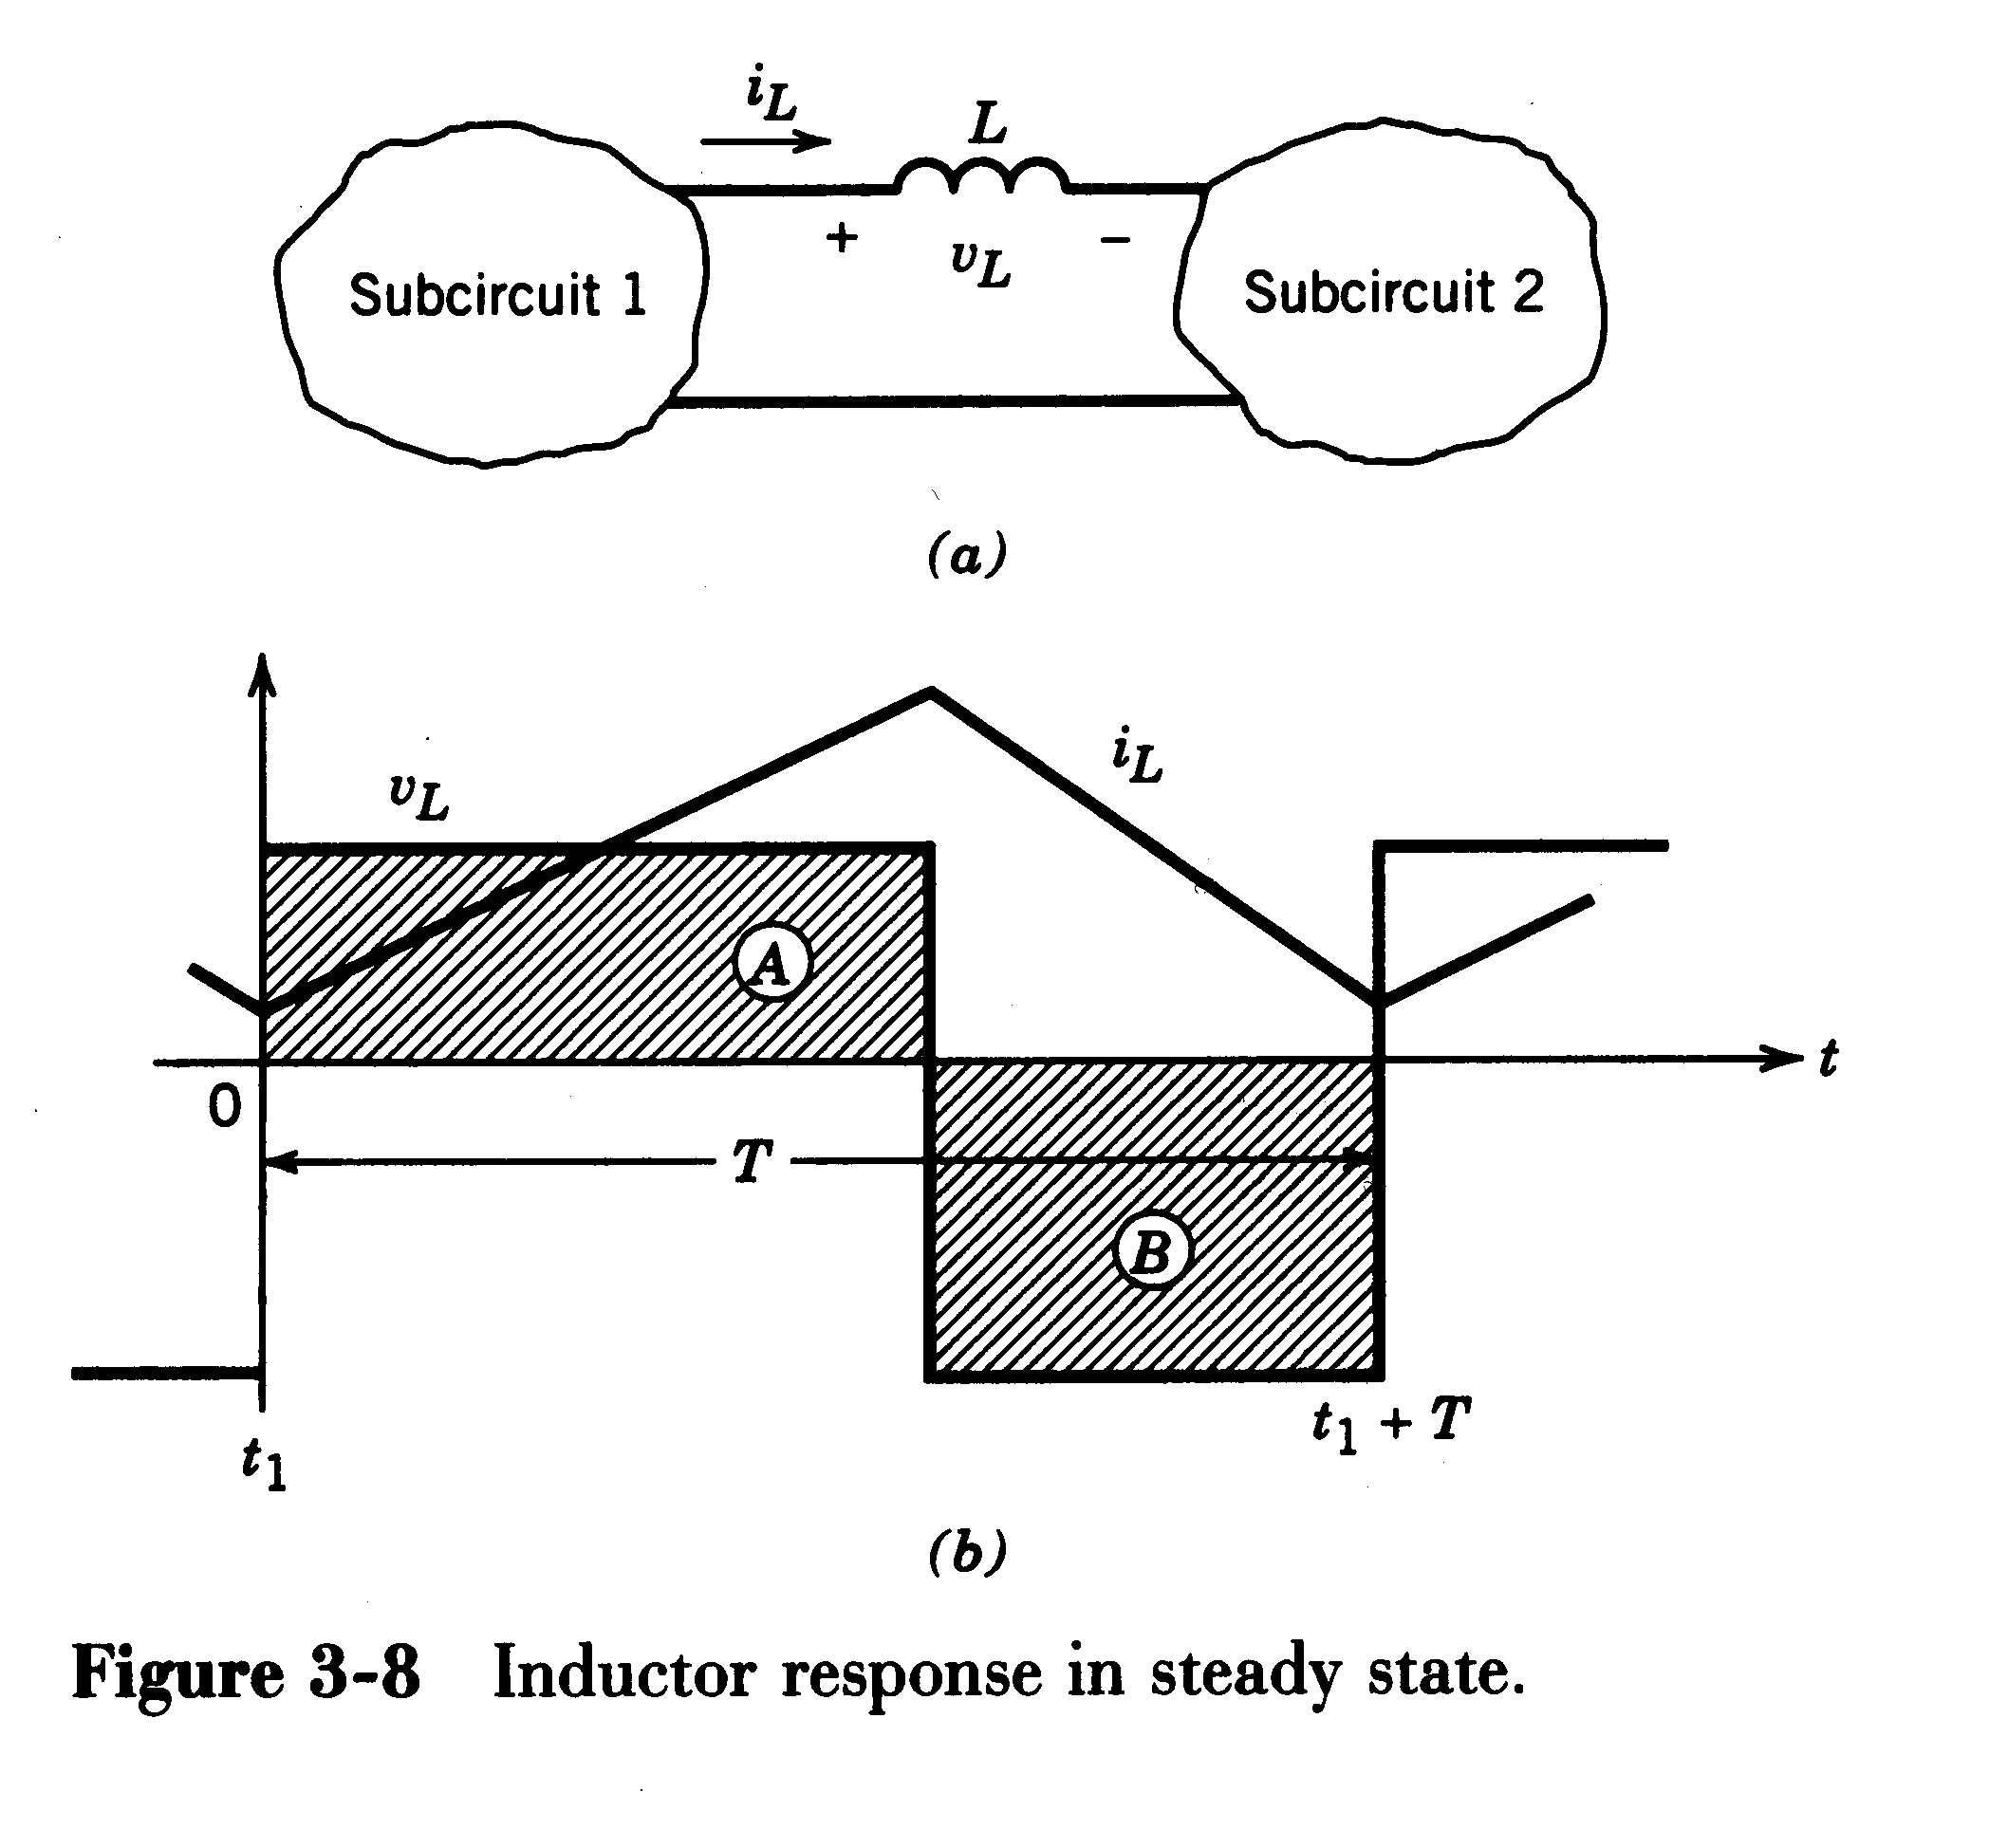
Inductor Voltage and Current in Steady State
Volt-seconds over T equal zero.
MTRN3026 Mechatronic Systems

Slide 20
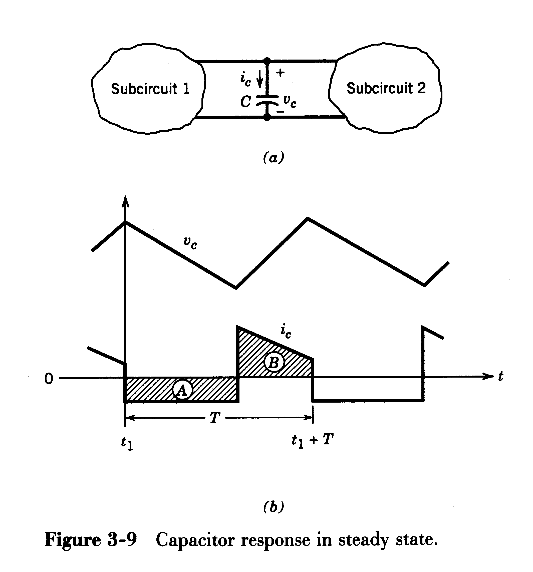
Capacitor Voltage and Current in Steady State
Amp-seconds over T equal zero.
MTRN3026 Mechatronic Systems

Slide 21
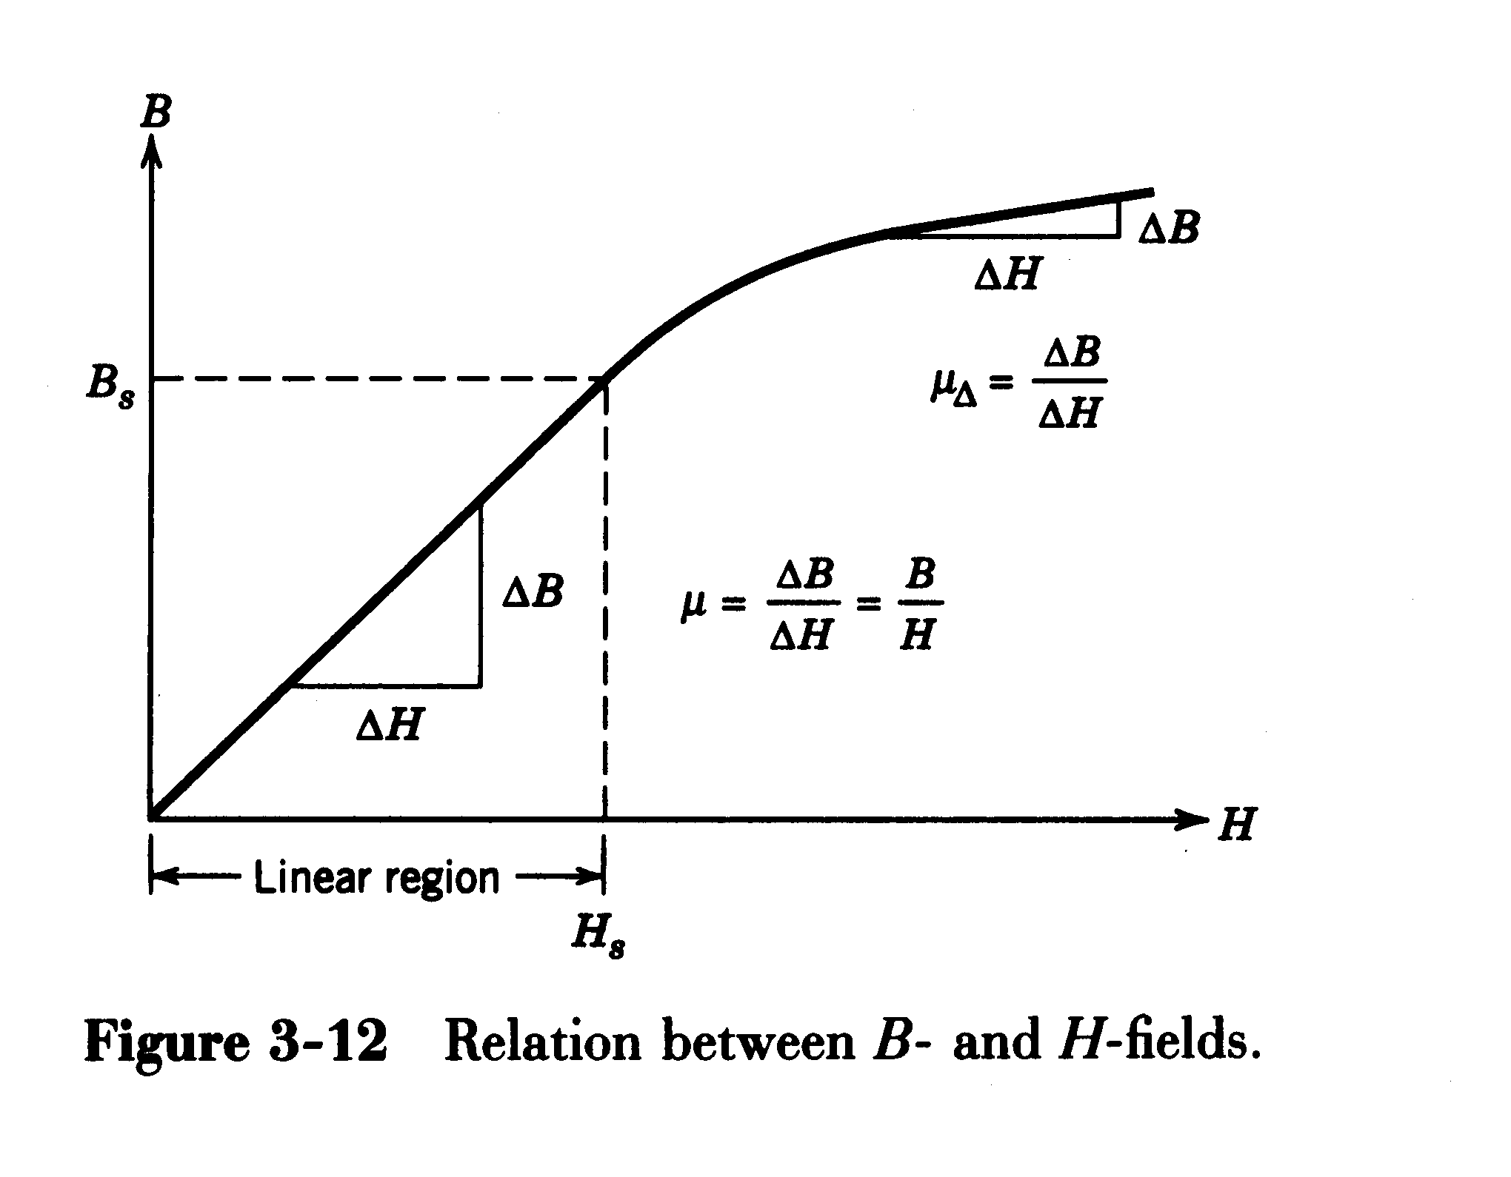
B-H Relationship; Saturation
MTRN3026 Mechatronic Systems

Slide 22
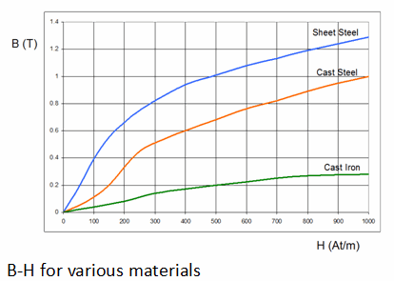
MTRN3026 Mechatronic Systems

Slide 23
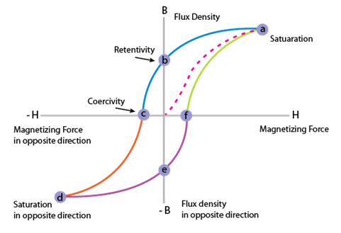
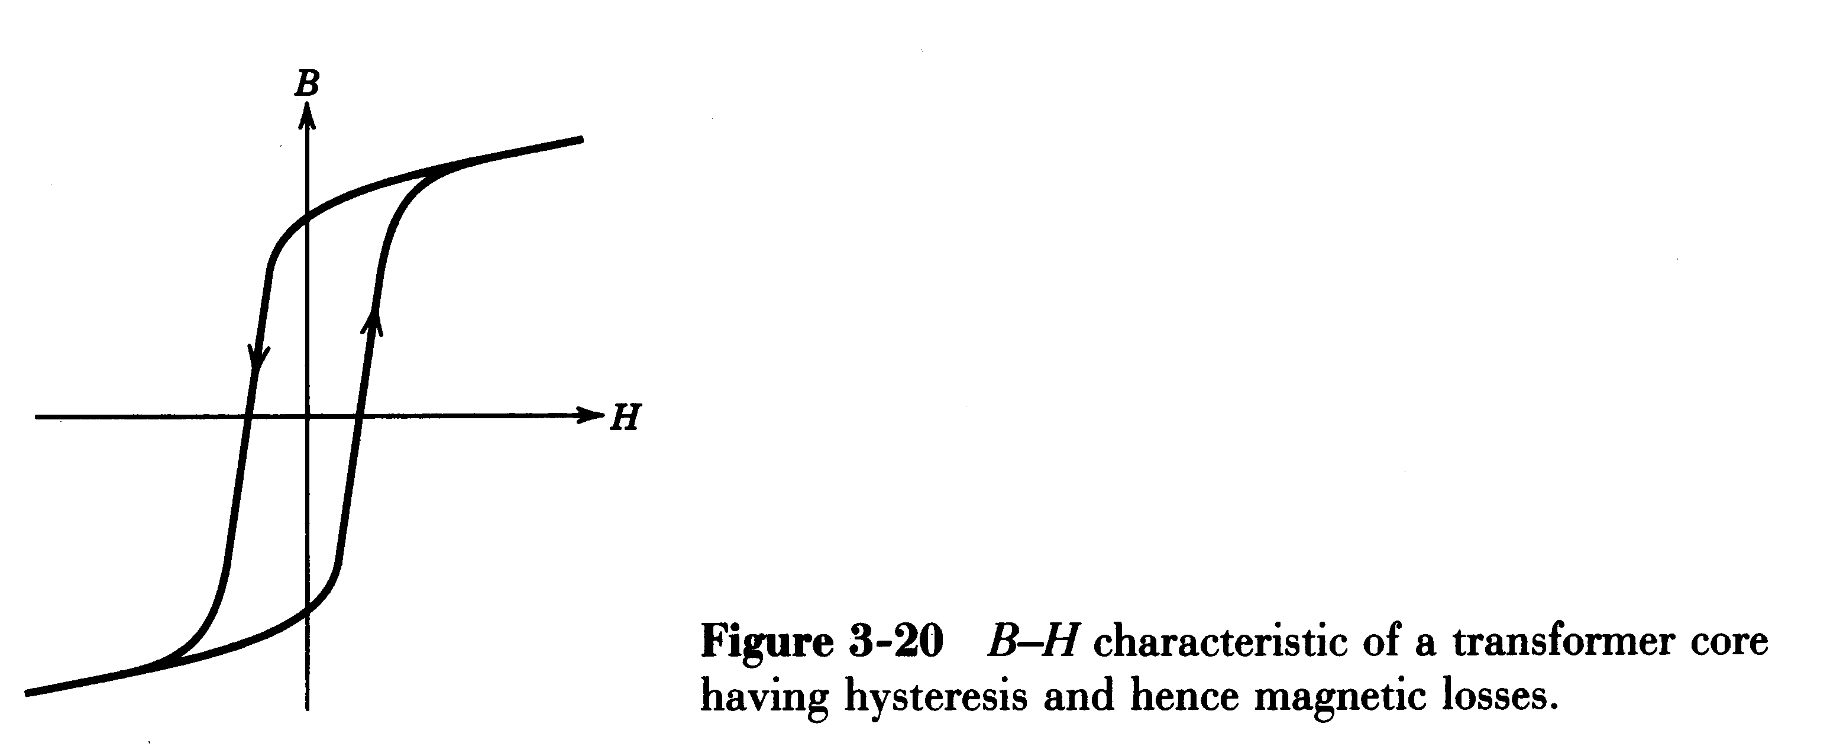
B-H characteristic of transformer core
MTRN3026 Mechatronic Systems

Slide 24
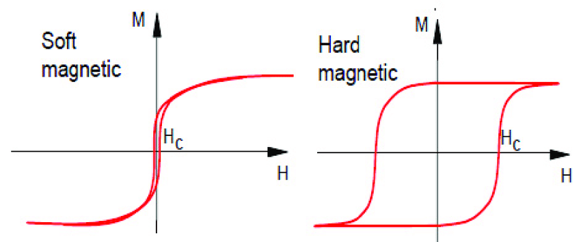
Soft and Hard Magnetic Material
MTRN3026 Mechatronic Systems

Slide 25
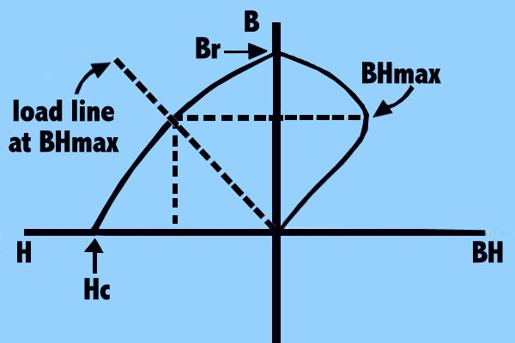
Permanent magnet characteristics
MTRN3026 Mechatronic Systems

Slide 26
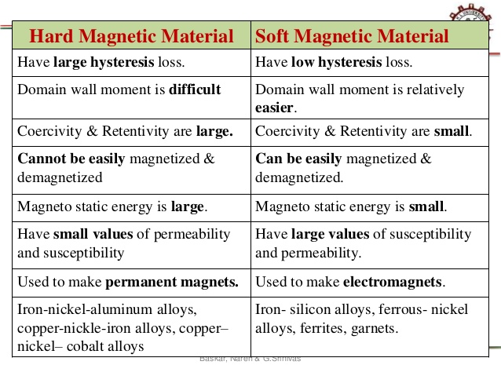
MTRN3026 Mechatronic Systems

Slide 27
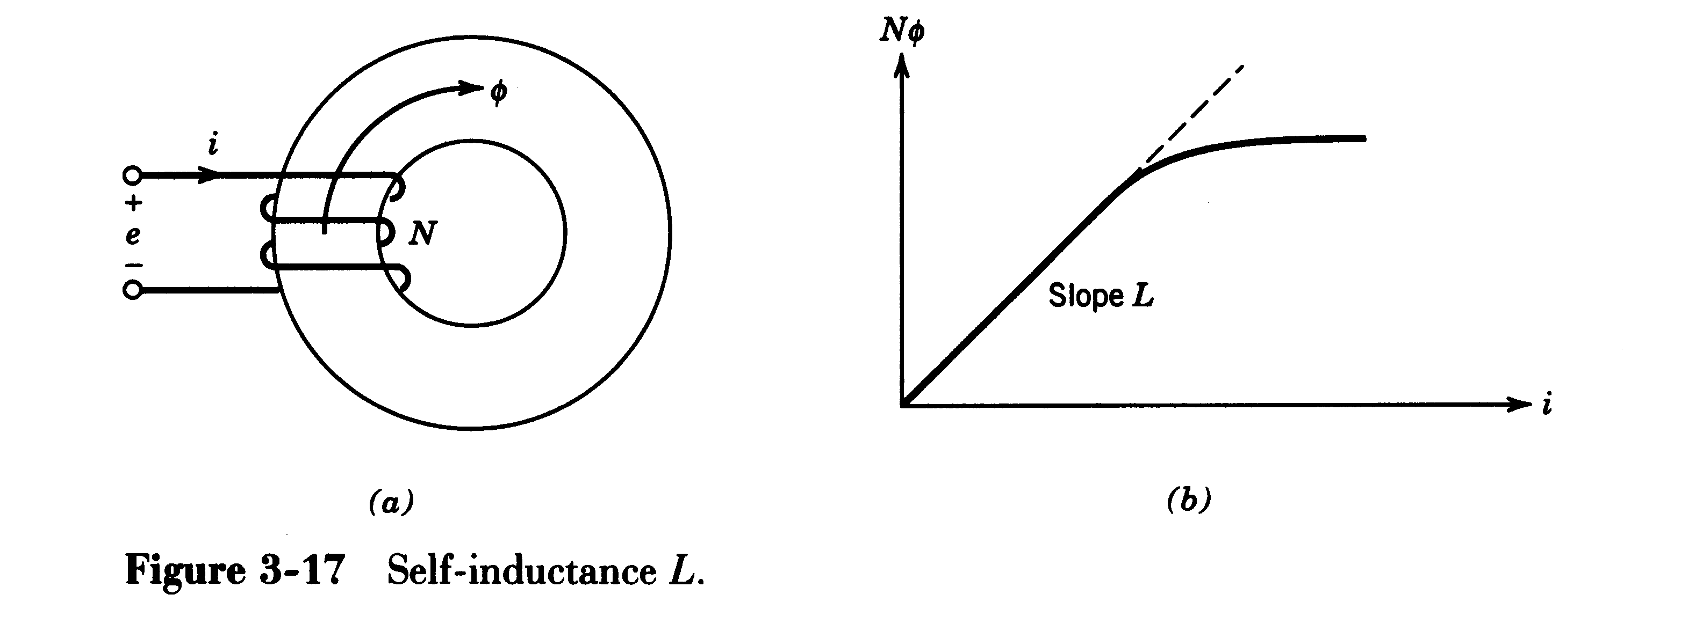
Inductance
MTRN3026 Mechatronic Systems

Slide 28
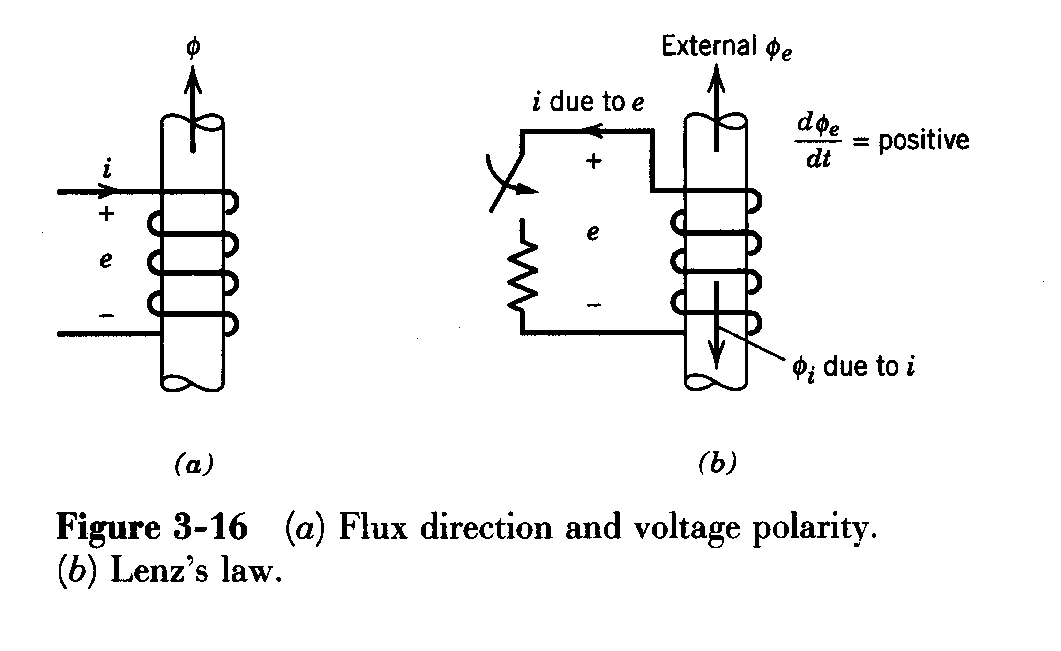
Faraday’s Law and Lenz’s Law
MTRN3026 Mechatronic Systems

Slide 29
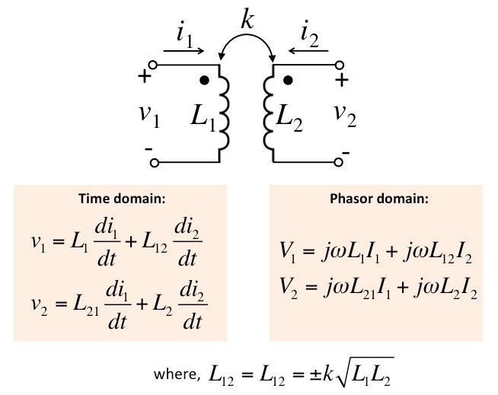
Coupled coils
MTRN3026 Mechatronic Systems

Slide 30
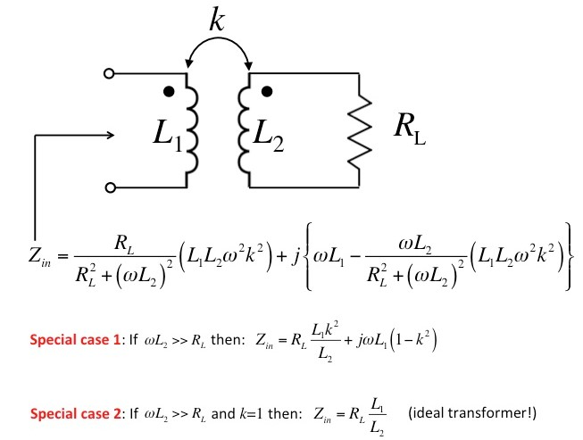
Exercise:
MTRN3026 Mechatronic Systems

Slide 31
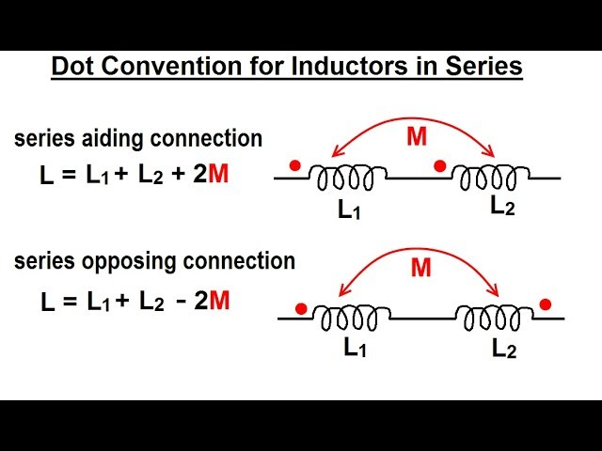
MTRN3026 Mechatronic Systems

Slide 32
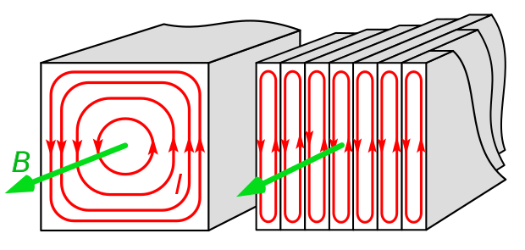
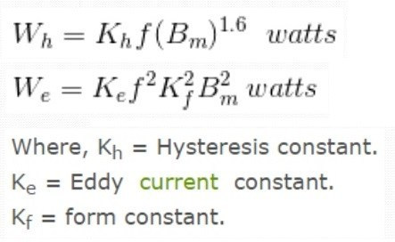
Eddy Current Loss
MTRN3026 Mechatronic Systems

Slide 33
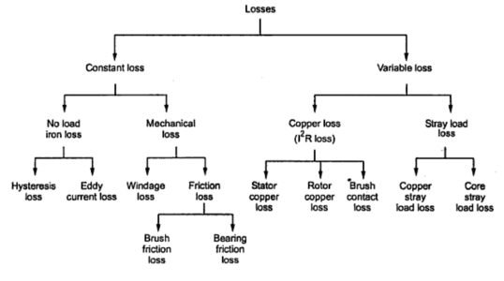
Different Losses in an Electrical Machine
MTRN3026 Mechatronic Systems

Slide 34
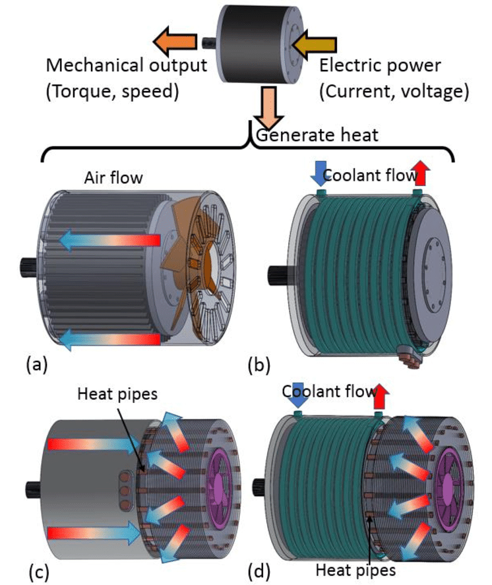
MTRN3026 Mechatronic Systems

Slide 35
Actuators
An actuator is a component of machines that is responsible for moving or controlling a mechanism or system. An actuator requires a control signal and source of energy. The control signal is relatively low energy and may be electric voltage or current, pneumatic or hydraulic pressure, or even human power.
MTRN3026 Mechatronic Systems

Slide 36

Turning Electrical Power into Mechanical Work
MTRN3026 Mechatronic Systems

Slide 37
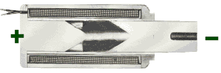
How a Solenoid Works?
Apply Current
Magnetic Field Builds
Stop and Plunger Become Attracting Magnets
Magnetic Force Drives Plunger to Stop
MTRN3026 Mechatronic Systems

Slide 38
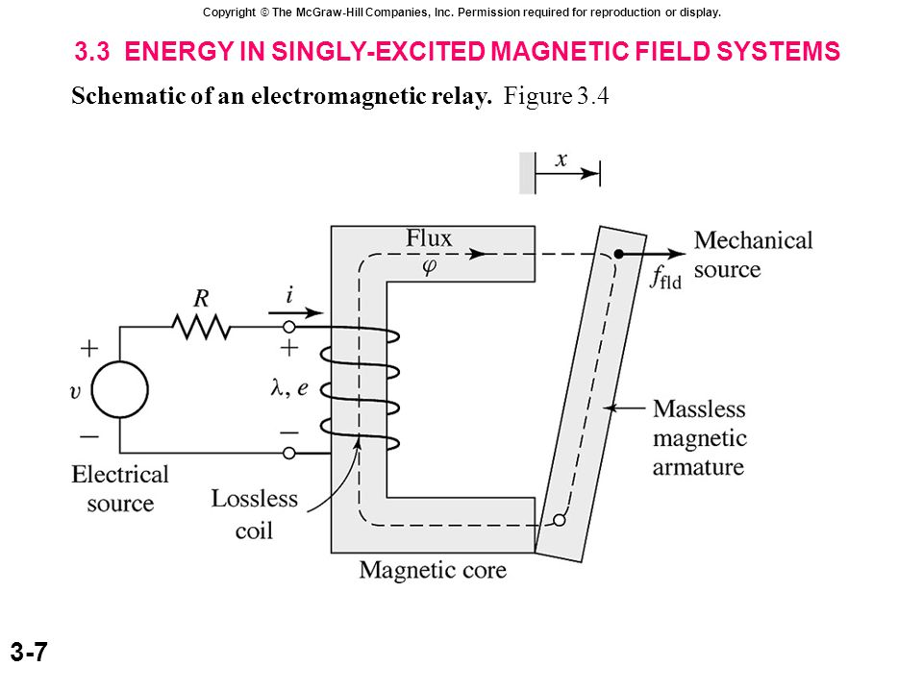

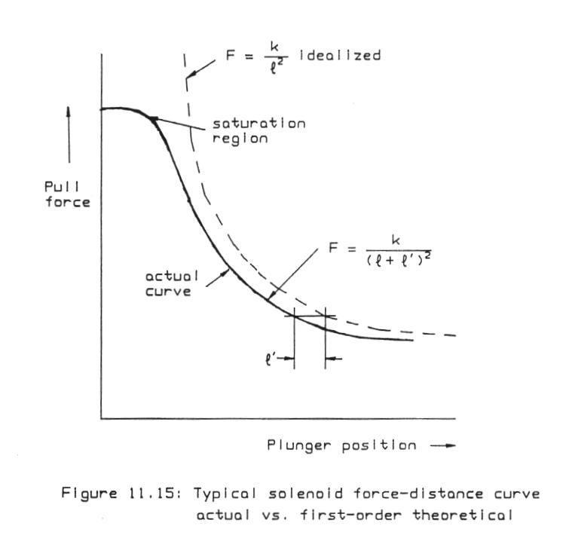

Force in a solenoid
MTRN3026 Mechatronic Systems

Slide 39




The relationship between the force, current and gap distance for an electromagnet is given by
Linearize the equation about an nominal operating point I_{o}, G_{o} and F_{o}.
Answer:
MTRN3026 Mechatronic Systems

